Slide 1
Methods in Functional Data Analysis:
Modeling Response Curves as Functions of
Experimental Factors in Designed Experiments
Jack DeGroot
August 14, 2023

Slide 2
Introduction

Slide 3
Summary
Functional data analysis (FDA) deals with the analysis and theory of data that are in the form of functions, images and shapes, or more general objects.
Focused on the curves produced from our Functional Data.
By modeling the entire functional curve, we can predict and understand behavior based on experimental changes.
In this project we investigate:
JMP's Fit Curve
Functional Principles Components (FPC)
A Bayesian Hierarchical Two-Stage Mixed-Effects model

Slide 4
Data
There are 3 datasets that we use in this Master Project:
Viscosity vs. Shear Rate
Fly-Ash
DoE 10 Factors

Slide 5
Background: SVEM
SVEM (Self-Validating Ensemble Model) is a necessary component for two of our three methods in this Master Project: Fit Curve and FPC (Functional Principles Components).
For implementation SVEM uses a bootstrapping procedure with a modified weighting scheme called fractional weighted bootstrapping (FWB).
Through this differentiated allocation, SVEM ensures a robust training model and an unbiased validation, optimizing the model's overall performance.

Slide 6
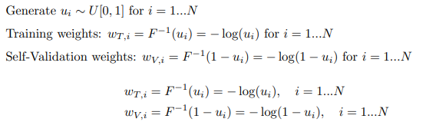
Background: SVEM
The fractional weights in SVEM are random draws from an exponential distribution with mean 1. Below, we observe the computation of the weights

Slide 7
Implementation

Slide 8
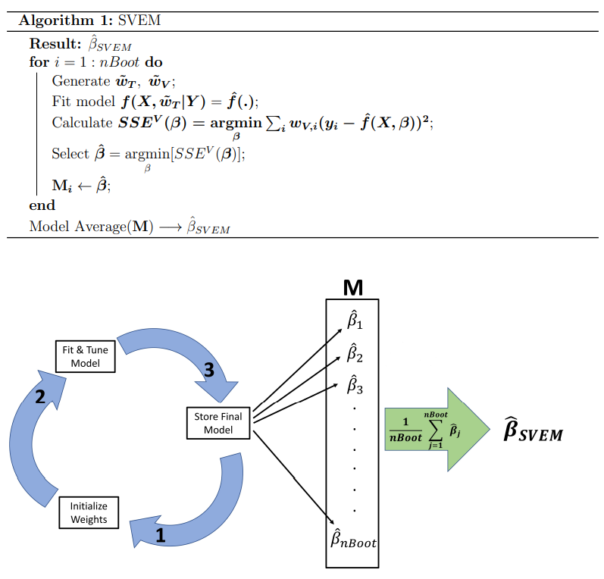
SVEM: JMP Implementation
Once the weights are assigned to the training and self-validation partitions, a model selection algorithm is applied to the training data.
For nBoot iterations, a matrix MnBoot,p0+1 containing all of the coefficient estimates is created to estimate the final ensemble model.

Slide 9
Method 1: JMP’s Fit Curve
We use JMP’s Fit Curve Method by clicking on the specialized modeling tab in Analyze.
Fit Curve enables users to fit models that are nonlinear in the parameters.
Important: All modeling we perform in nonlinear.
One of JMP's standout features is its ability to save a model's parameter table post the nonlinear fit.

Slide 10
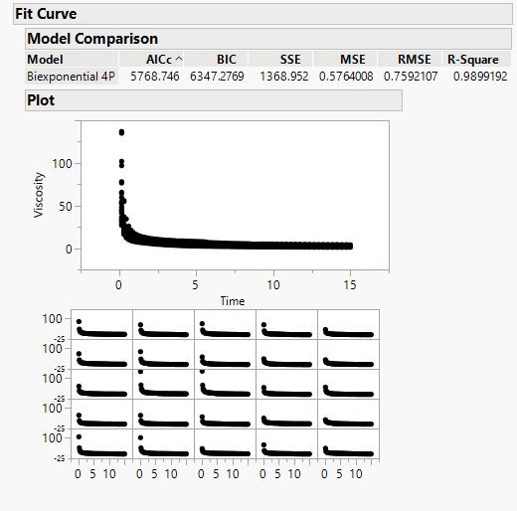
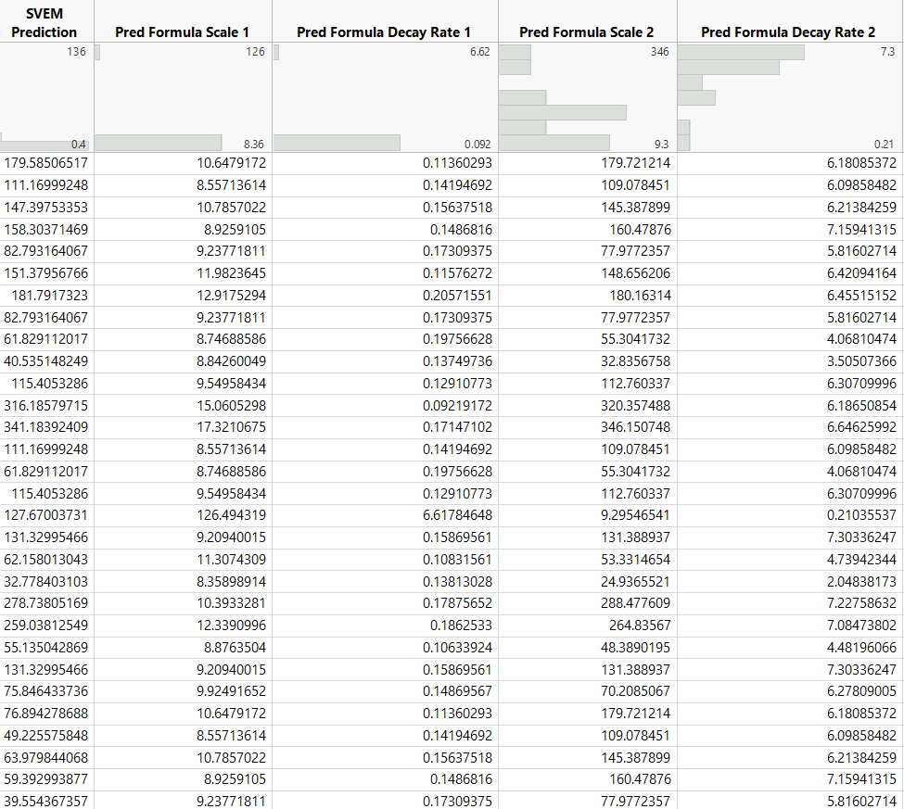
Method 1: JMP’s Fit Curve
For our Viscosity Data we use our Fit Curve Method to fit a 4 parameter bi-exponential model to our data.
We Obtain a R-Score of 0.989 showing that our data fits will to our model.
Our SVEM Prediction formulas from our Bi-Exponential Model as well as out Predictions.
Bi-Exponential Prediction Formula displayed above.

Slide 11
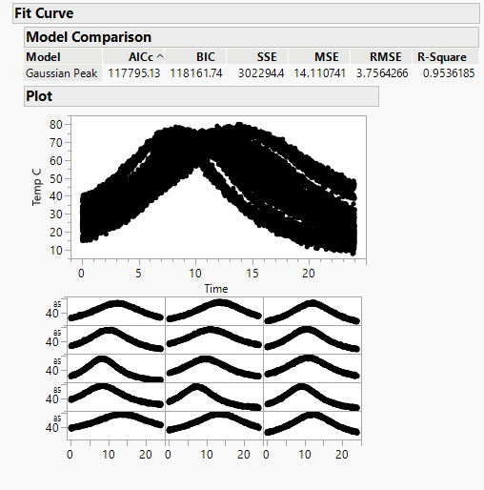
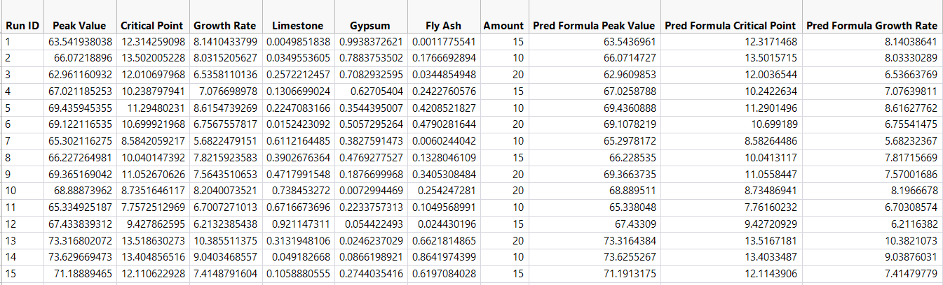
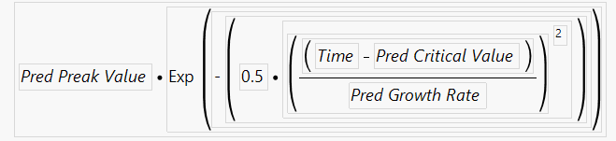
Method 1: JMP’s Fit Curve
For our Fly-Ash Data we use our Fit Curve Method to fit a Peak Gaussian model to our data.
We Obtain a R-Score of 0.954 showing that our data fits will to our model.
Our SVEM Prediction formulas from our Peak Gaussian Model as well as out Predictions.
Peak Gaussian Prediction Formula displayed above.

Slide 12
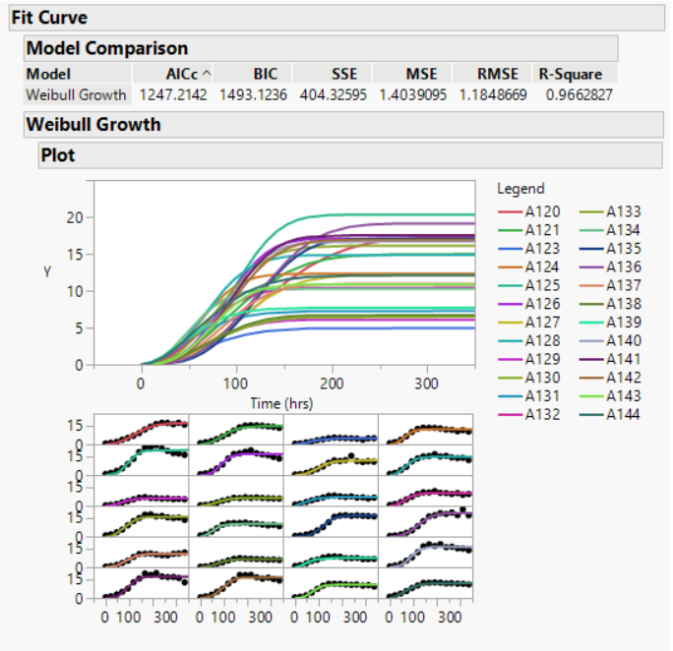
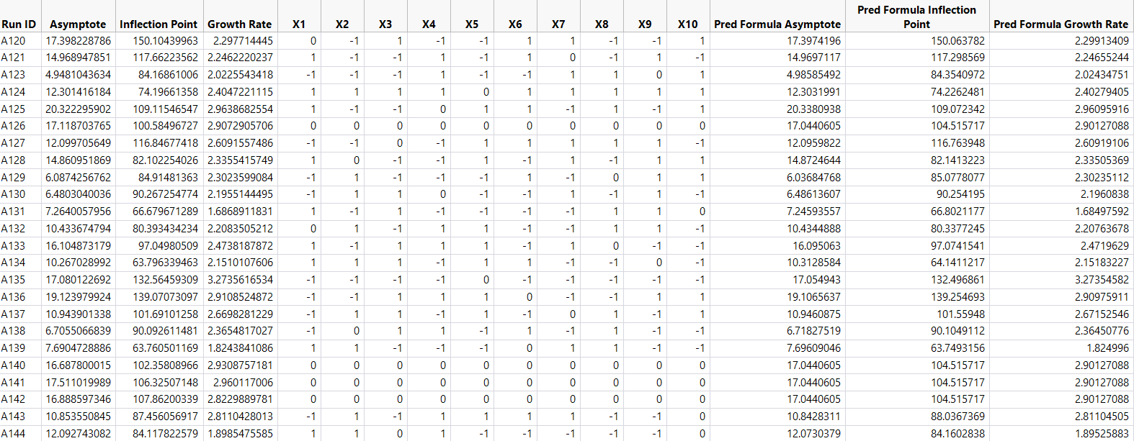
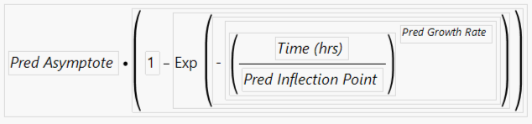
Method 1: JMP’s Fit Curve
For our DoE 10 Factor Data we use our Fit Curve Method to fit a Weibull Growth model to our data.
We Obtain a R-Score of 0.966 showing that our data fits will to our model.
Our SVEM Prediction formulas from our Weibull Growth Model as well as out Predictions.
Weibull Growth Prediction Formula displayed above.

Slide 13
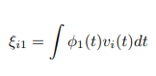
Method 2: FPC
The Functional Principal Components technique is an approach used to reduce the dimensionality of large datasets while helping to enhance interpretability, yet loses minimum information from the data.
The first functional principal component, ϕ1(t), is chosen to maximize mean square, ensuring comprehensive understanding of the data distribution. Where:
with the constraint of the unit squared norm:

Slide 14
Method 2: FPC
The Second and (if needed) additional FPC’s can be found by solving the same optimization problem with the additional orthogonality constraints of:
JMP provides a user friendly platform for us to model ser friendly and allows us to easily model the Functional Principal Components as functions of the experimental factors.
We use the functional data explorer as the first step in implementing FPC method for our data

Slide 15
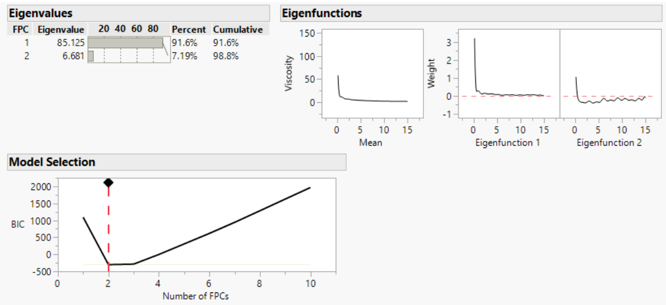
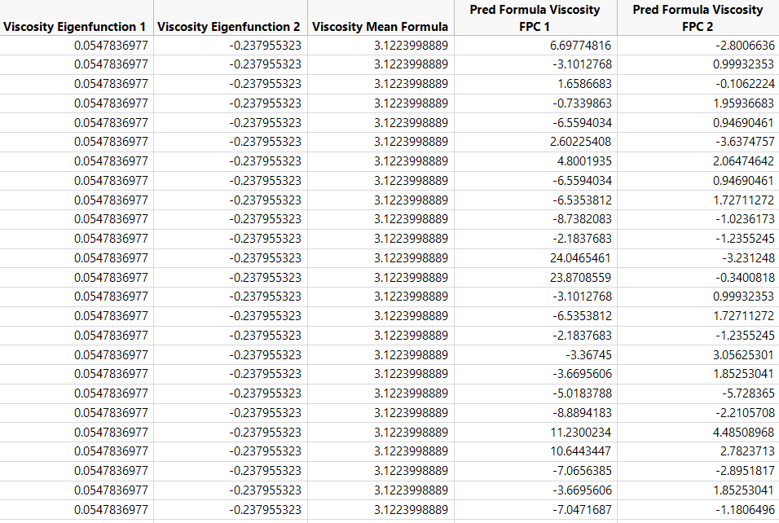
Method 2: FPC
For our Viscosity Data we use 2 eigenfunctions and a B spline model consisting of 3 degrees and 20 knots. .
Our 2 Eigenfunctions cover 98.8% of the Data’s variance.
Our EigenFunction Formulas and Predictions Formulas from SVEM are displayed above.
Our Prediction Formula for FPC is shown above.

Slide 16
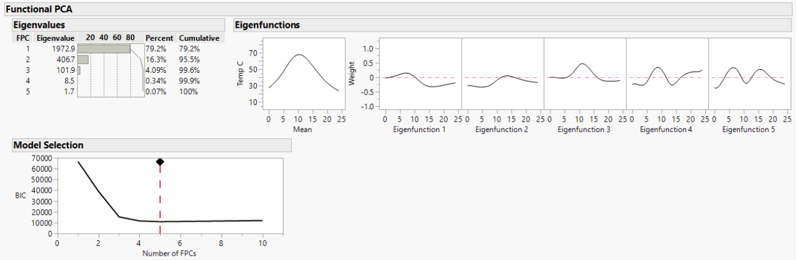
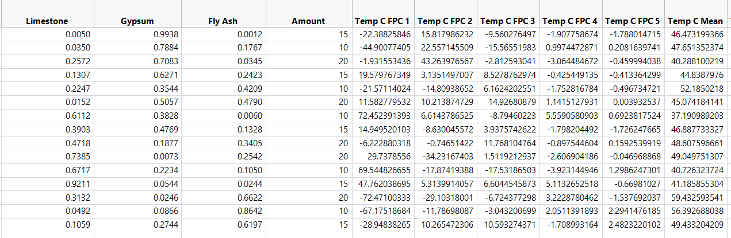
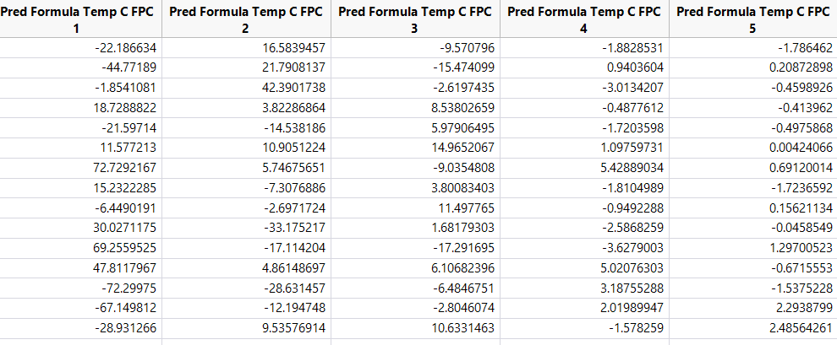
Method 2: FPC
For our Fly-Ash Data we use 5 eigenfunctions and a B spline model consisting of 3 degrees and 7 knots. .
Our 5 Eigenfunctions cover 100% of the Data’s variance.
Our Prediction Formula for FPC is shown above.
Our EigenFunction Formulas and Predictions Formulas from SVEM are displayed above

Slide 17
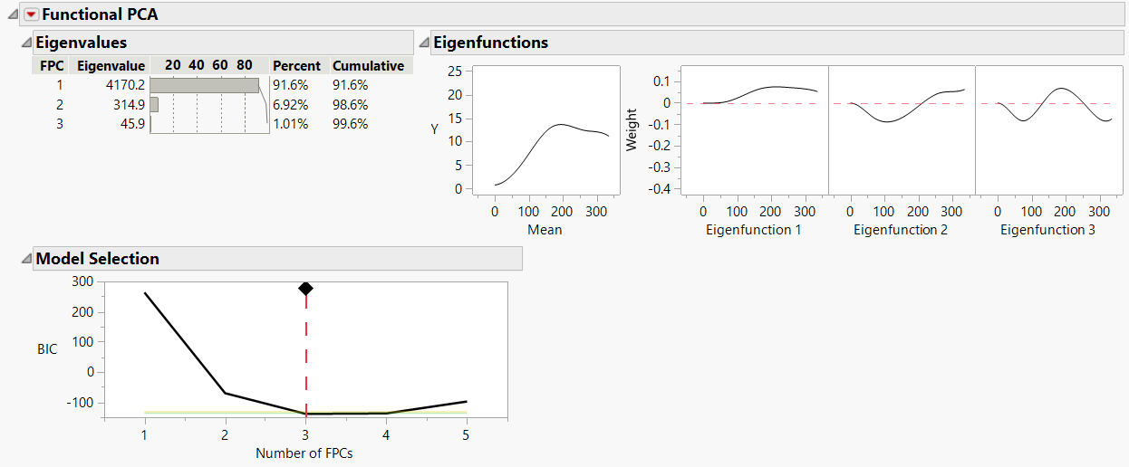
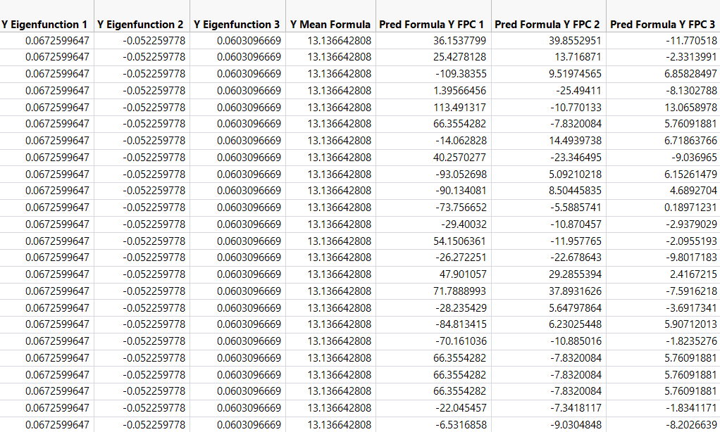
Method 2: FPC
For our DoE10 Factor Data we use 3 eigenfunctions and a B spline model consisting of 3 degrees and 3 knots. .
Our 3 Eigenfunctions cover 99.6% of the Data’s variance
Our EigenFunction Formulas and Predictions Formulas from SVEM are displayed above.
Our Prediction Formula for FPC is shown above.

Slide 18
Method 3: Bayesian Hierarchical Two-Stage Mixed-Effects (1)
Introduced from the research paper ”Bayesian Modeling and Optimization of Functional Responses Affected by Noise Factors” written by Enrique Del Castillo, Bianca M. Colosimo, and Hussam Alshraideh.
The method involves a two-stage procedure:
Fit a linear model based on splines to the data.
Model each parameter as a quadratic polynomial in the two factors using Gibbs Sampling from Markov Chain Monte Carlo Method.
We run our Bayesian Hierarchical Two-Stage Mixed-Effects Method in MATLAB and R.

Slide 19
Method 3: Bayesian Hierarchical Two-Stage Mixed-Effects (2)
Set Up In MATLAB: Bayesian Hierarchical Two-Stage Mixed-Effects
After extensive hours working on the MATLAB code, I had got the examples from research paper to properly work.
Problems:
The MATLAB functions is coded so that the model assumes a linear relationship between the dependent variable and independent variables with both fixed and random effects.
In all of our examples we do not utilize a linear model so there occurs a problem.
The code is outdated and not optimized with the latest packages and up to date technology. It was created in 2008 with a last code modification in July of 2009

Slide 20
Method 3: Bayesian Hierarchical Two-Stage Mixed-Effects (3)
Set Up In MATLAB: Bayesian Hierarchical Two-Stage Mixed-Effects
We discuss the results found from the MATLAB code in the Results section of this Presentation.
Due to the problems occurring in the MATLAB code, there was a decision made to transfer the code from MATLAB to R so that the proper updates and modification could be made.
During Transfer from MATLAB to R we were predominantly focused on MATLAB functions with MCMC Gibbs sampling and Bayesian optimization analysis which was performed in the MCMCMixed Effects MATLAB File.

Slide 21
Method 3: Bayesian Hierarchical Two-Stage Mixed-Effects (4)
Set Up In MATLAB: Bayesian Hierarchical Two-Stage Mixed-Effects
Specifically, the MCMCMixed Effects MATLAB File defines priors for coefficients (beta), inverse covariance matrix (DInv), and residual variance (sigma2). Initial samples are then generated from priors to start MCMC simulation.
During MCMC iteration, parameters are updated from full conditional distributions. Chib and Carlin algorithms are used for sampling beta.
Parameter values for the posterior distributions of parameters from each MCMC iteration stored in the "pars" cell array.
After matrix transformation and some calculations we obtain estimates for the mean posterior parameter for each run in relation to experimental designs.

Slide 22
Method 3: Bayesian Hierarchical Two-Stage Mixed-Effects (5)
Set Up In R: Bayesian Hierarchical Two-Stage Mixed-Effects
We use the brm function from the brms package in R, which stands for Bayesian regression models using Stan. This is how we implement our Bayesian Hierarchical Model
We use a Sheffé's polynomial for our formula for all three methods in our Bayesian Model to ensure that we remove the intercept term.
prior1 specifies a normal distribution with a mean of 0 and standard deviation of 100 for the regression coefficients.

Slide 23
Method 3: Bayesian Hierarchical Two-Stage Mixed-Effects (6)
Set Up In R: Bayesian Hierarchical Two-Stage Mixed-Effects
prior2 is for the standard deviation of the random effects associated with RunID, again assuming a normal distribution with mean 0 and standard deviation 100.
A max tree depth of 17 was used in the Hamiltonian Monte Carlo sampling.
The model is set to run with 4 cores.
The model is set to run for 4,000 iterations, which should help in achieving a good convergence.

Slide 24
Results

Slide 25
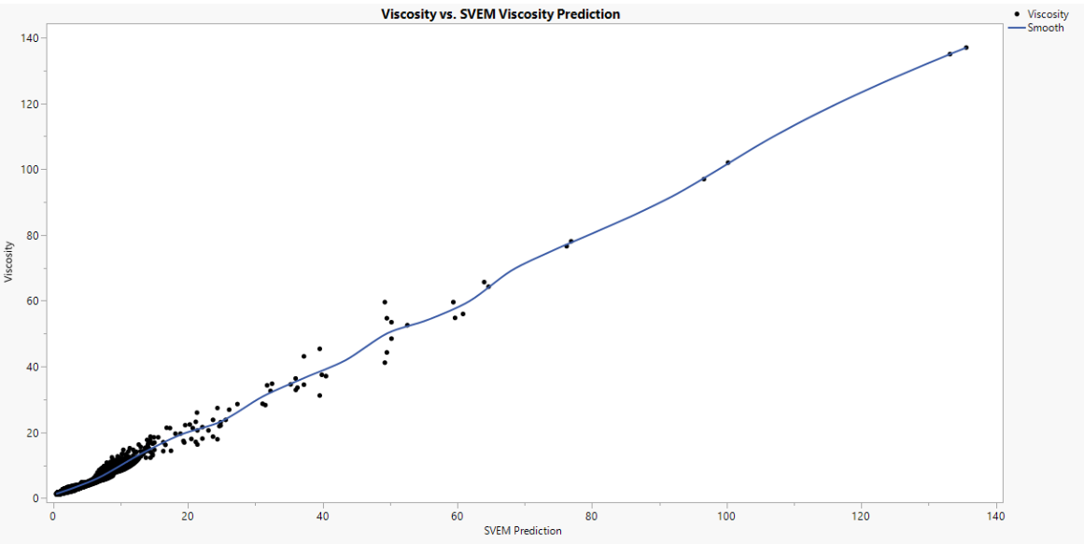
Example 1: Viscosity Data
Method: Fit Curve
A clear diagonal linear trend is observed.
Variation Increases as Viscosity Value increases
There are few large Viscosity Values so not much of concern.
Actual by Predicted plot for our Fit Curve Method

Slide 26
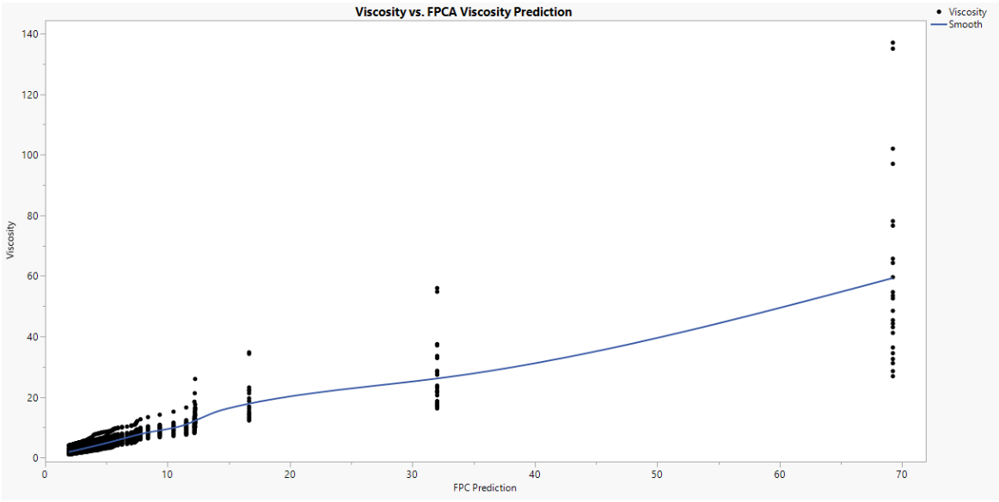
Example 1: Viscosity Data
Method: FPC
A less than diagonal trend is observed.
FPC looks to not be a preferred method working with this Data set
Variation Increases as Viscosity Value increases.
There seems to be accuracy in our prediction but not specific.
Actual by Predicted Plot for FPC Method

Slide 27
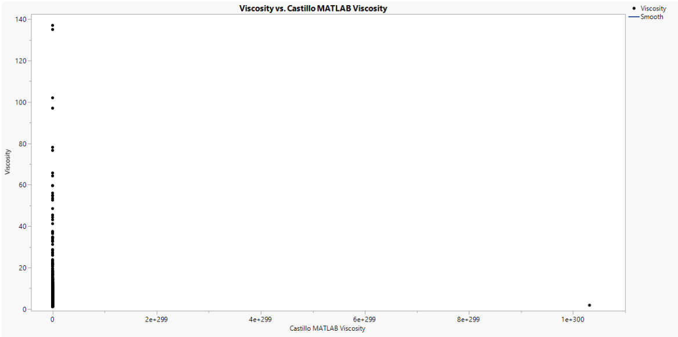
Example 1: Viscosity Data
Method: Bayesian Hierarchical Two-Stage Mixed-Effects (MATLAB)
This is a horrible fit.
Our Predicted Values Scale is not near the range of our Actual Viscosity Values.
Complete Vertical Line with no indication of Fit.
Actual by Predicted plot for our Bayesian Hierarchical Two-Stage Mixed-Effects Method

Slide 28
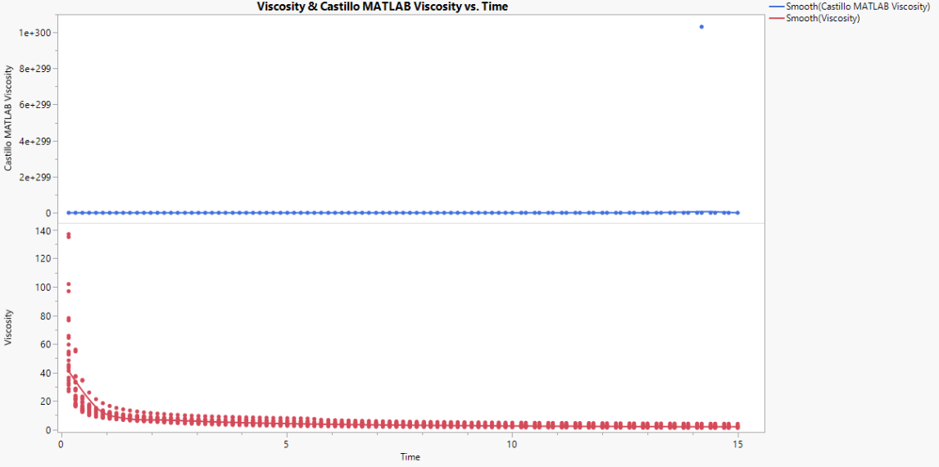
Example 1: Viscosity Data
The Range of Prediction is nowhere near the Actual Viscosity Values.
Observed Prediction trend is not similar to Actual Viscosity by Time Trend
Comparison of Actual by Predicted plot for our Bayesian Hierarchical Two-Stage Mixed-Effects Method (MATLAB)

Slide 29
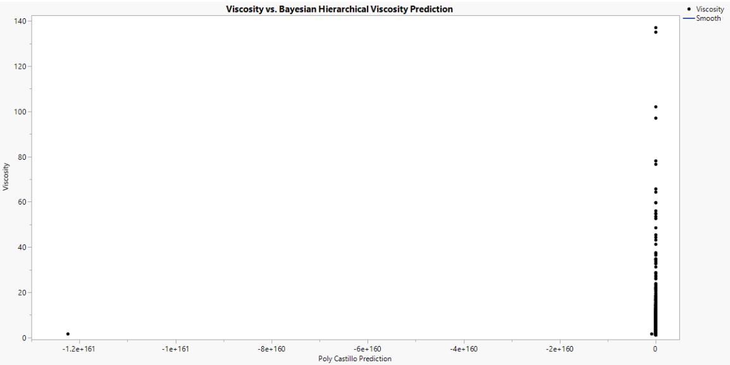
Example 1: Viscosity Data
Method: Bayesian Hierarchical Two-Stage Mixed-Effects
Vertical Line Instead of a Exponential Decreasing Trend.
Prediction Viscosity Scale is nowhere near the range of the Actual Viscosity Values.
Actual by Predicted plot for our Bayesian Hierarchical Two-Stage Mixed-Effects Method (R)

Slide 30
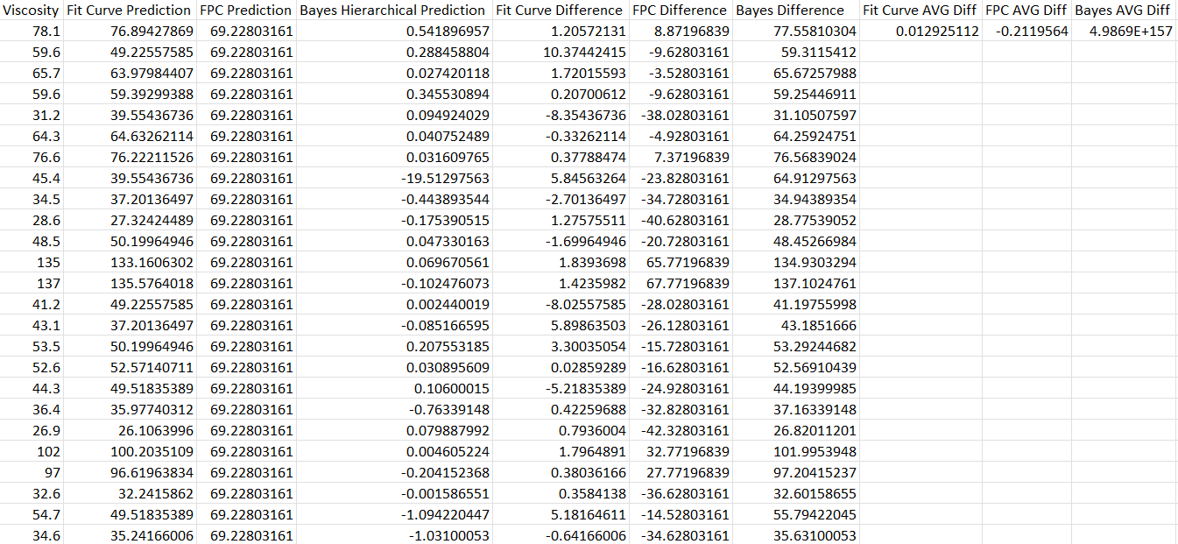
Example 1: Viscosity Data
Predicted Values against our Actual Viscosity values for our Viscosity Data. We also compute the average difference between actual and predicted values for each method for comparison.

Slide 31
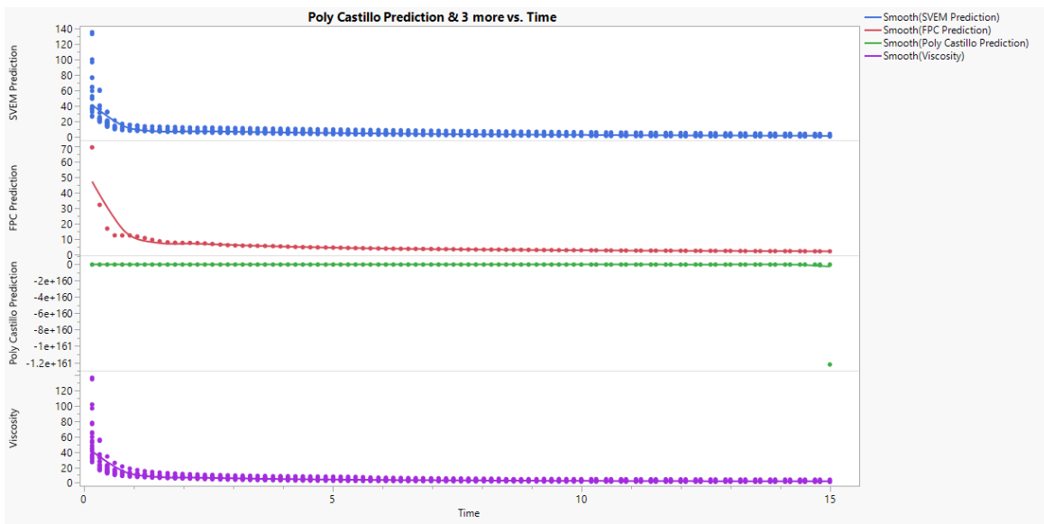
Example 1: Viscosity Data
Fit Curve and FPC both display similar trends compared Actual Viscosity Values.
Our Bayes Method performs awful in prediction.
Overall Fit Curve Method provides us with the most accurate predictions for Viscosity.
Comparison of Actual by Predicted plots

Slide 32
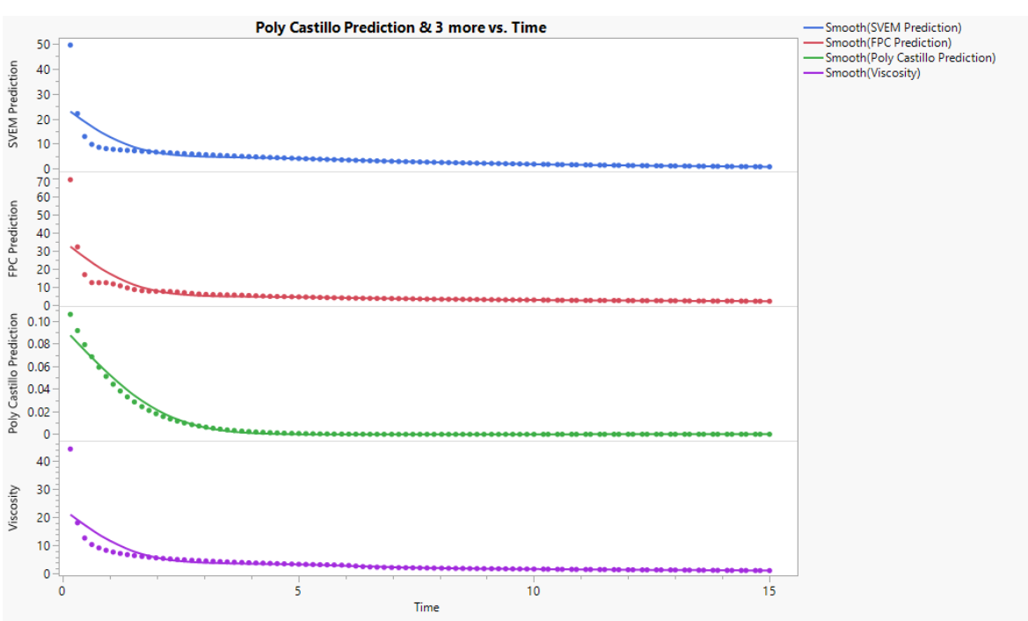
Example 1: Viscosity Data
Specifically looking at Run 18 of our Data we can see that all three methods display a exponential decreasing trend.
However our Bayes Method provides a Scale for its Predictions Viscosity Values that are nowhere near the Actual Viscosity Values.
Comparison of Actual by Predicted plots

Slide 33
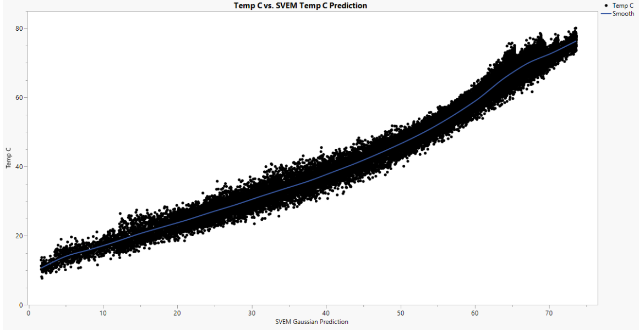
Example 2: Fly-Ash Data
Method: Fit Curve
A clear linear diagonal trend is observed.
Variation is constant throughout the whole plot, hence predictions vs. actual TempC values are reasonable.
Actual by Predicted plot for our Fit Curve Method

Slide 34
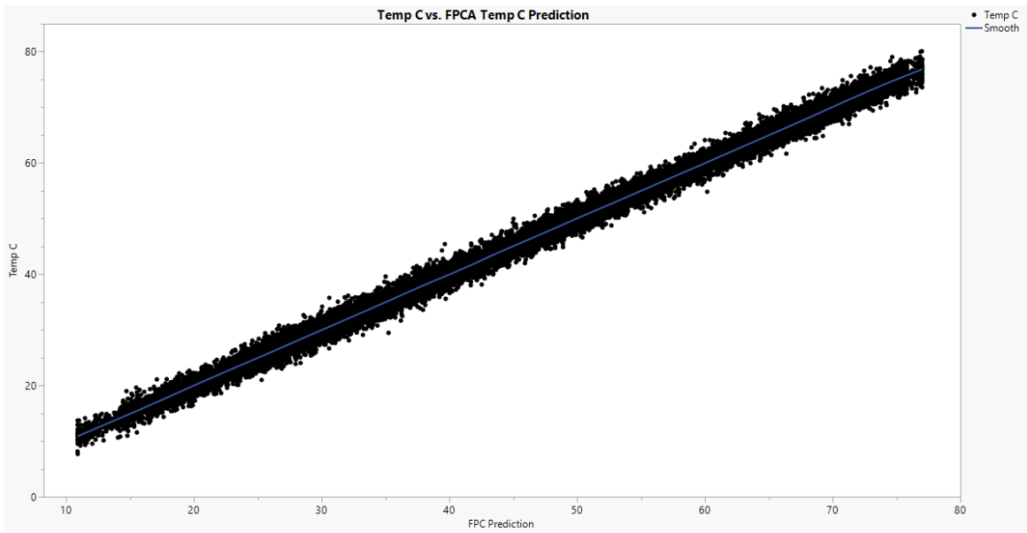
Example 2: Fly-Ash Data
Method: FPC
A VERY ClEAR linear diagonal trend is observed.
Variation is strictly constant throughout the whole plot, hence predictions vs. actual TempC values are reasonable.
Our FPC Method is much improved on prediction for this Fly-Ash data than our previous Viscosity Data.
Actual by Predicted plot for our FPC Method

Slide 35
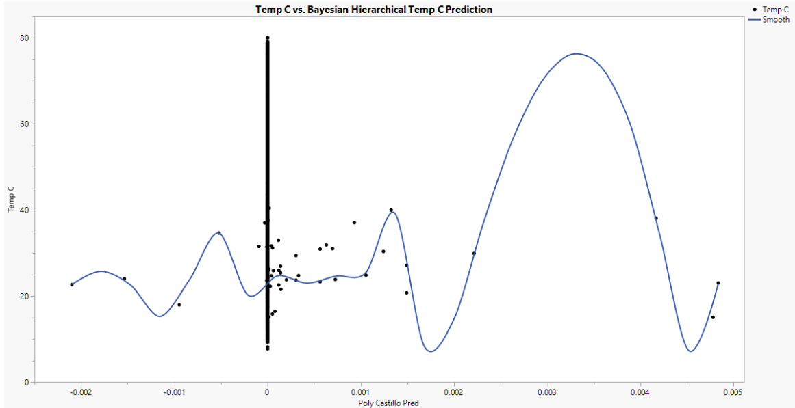
Example 2: Fly-Ash Data
Method: Bayesian Hierarchical Two-Stage Mixed-Effects
A vertical trend is observed.
Mutiple predictions are all randomly placed throughout the plot, hence the predictions are not near their actual TempC values.
Actual by Predicted plot for our Bayesian Hierarchical Two-Stage Mixed-Effects Method.

Slide 36
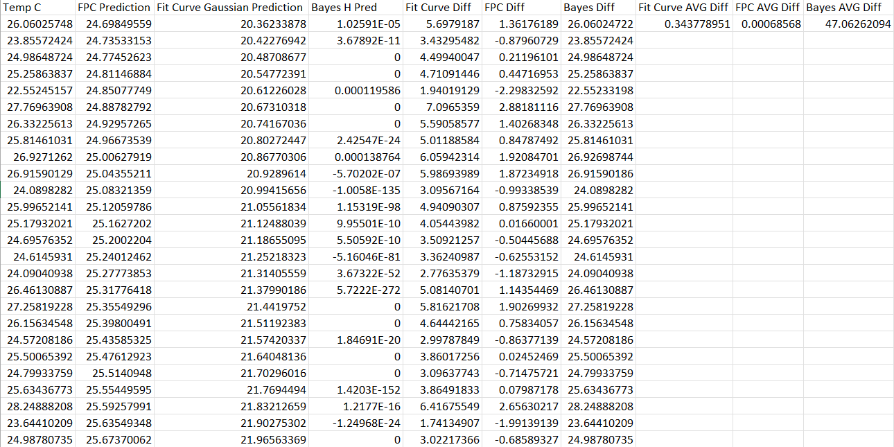
Example 2: Fly-Ash Data
Predicted Values against our Actual TempC values for our Fly-Ash Data. We also compute the average difference between actual and predicted values for each method for comparison.

Slide 37
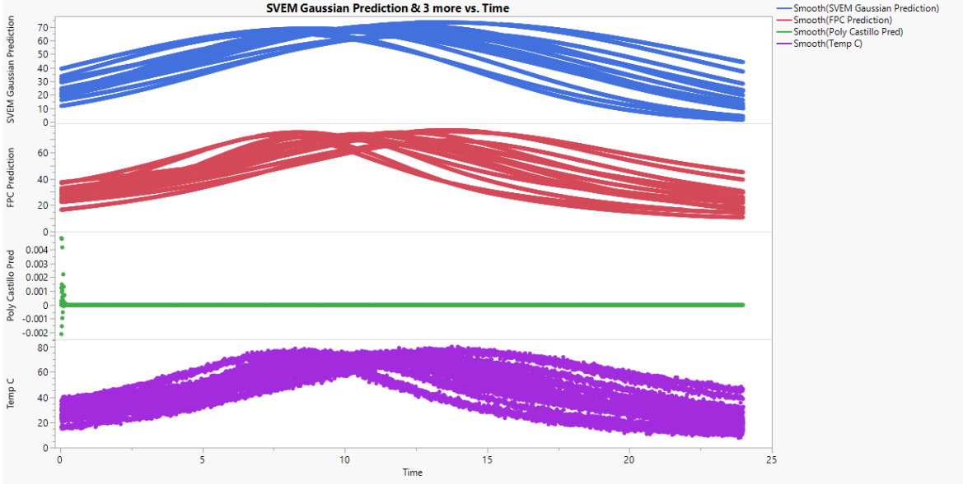
Example 2: Fly-Ash Data
Our Fit Curve and FPC Method prediction vs. Time plots look exceptionally similar to our Actual vs. Time plot.
Our Bayesian Bayesian Hierarchical Two-Stage Mixed-Effects Method produces a linear line instead of a Curve for its predictions of TempC.
Overall Plot Comparison of our Actual and Predicted TempC values vs. Time for Fly-Ash Data

Slide 38
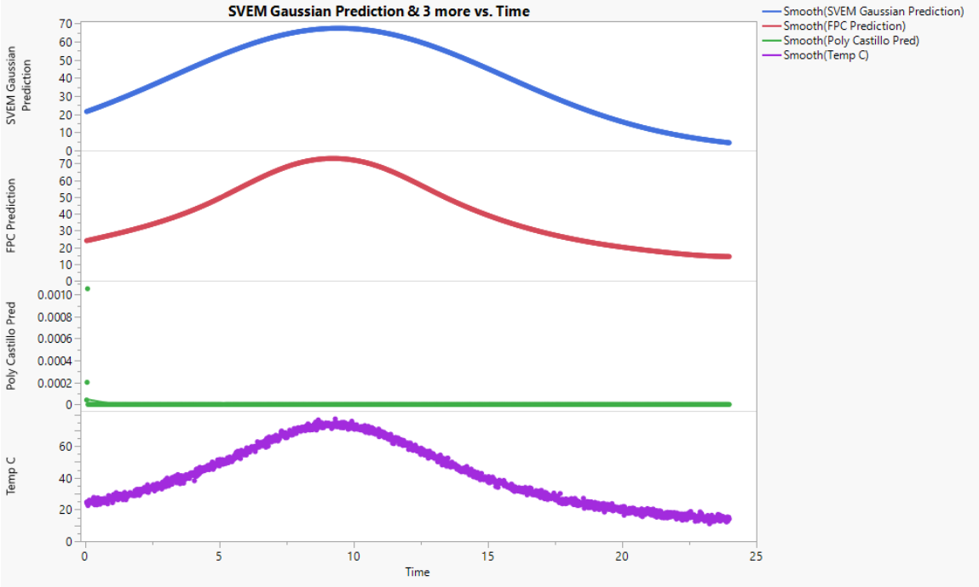
Example 2: Fly-Ash Data
Our Fit Curve and FPC Method prediction vs. Time plots for Run 12 looks to be more similar in precise shape compared to our Actual Temp C vs. Time plot.
Our FPC Method prediction vs. Time plots for Run 12 looks to be more similar in precise shape than our Fit Curve Method, hence we can assume that FPC performs better than Fit Curve for our Fly-Ash Data.
Predicted & Actual TempC vs. Time Plot Comparison of Run 12 of our Fly-Ash Data

Slide 39
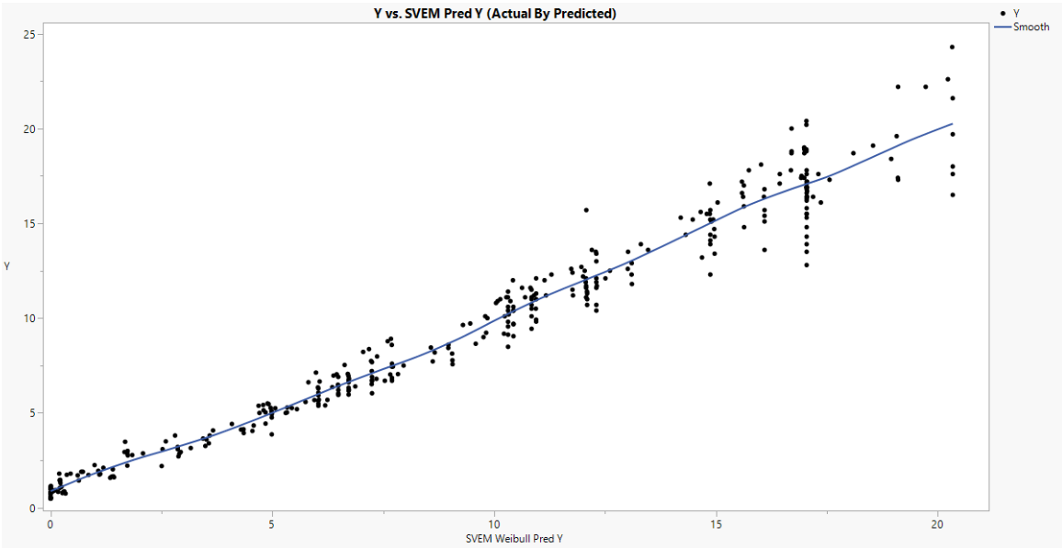
Example 3: DoE 10 Factor Data
Method: Fit Curve
A diagonal linear trend is observed.
Variation seems to increase as the Prediction size values for Y increase.
Overall Fit Curve seems to be predicting Y values accurately.
Actual by Predicted plot for our Fit Curve Method

Slide 40
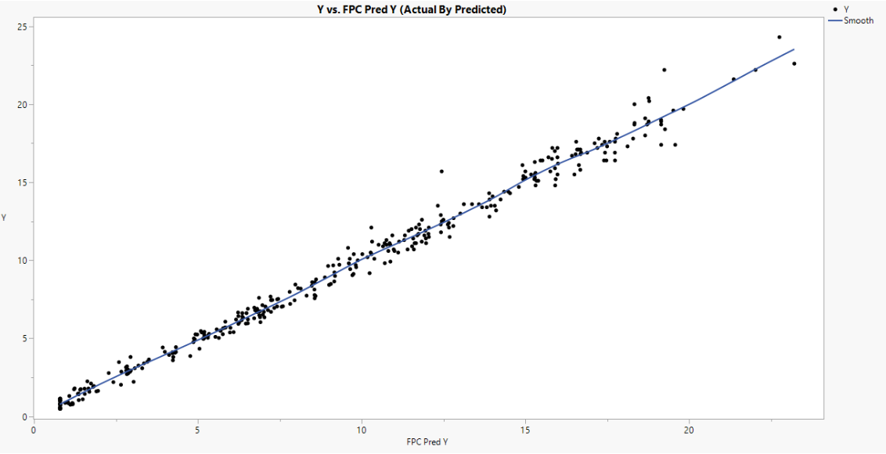
Example 3: DoE 10 Factor Data
Method: FPC
A diagonal straight linear trend is observed.
Variation seems to stay small and constant as Y increases.
Overall FPC seems to be predicting Y values better than our Fit Curve Method.
Actual by Predicted plot for our FPC Method

Slide 41
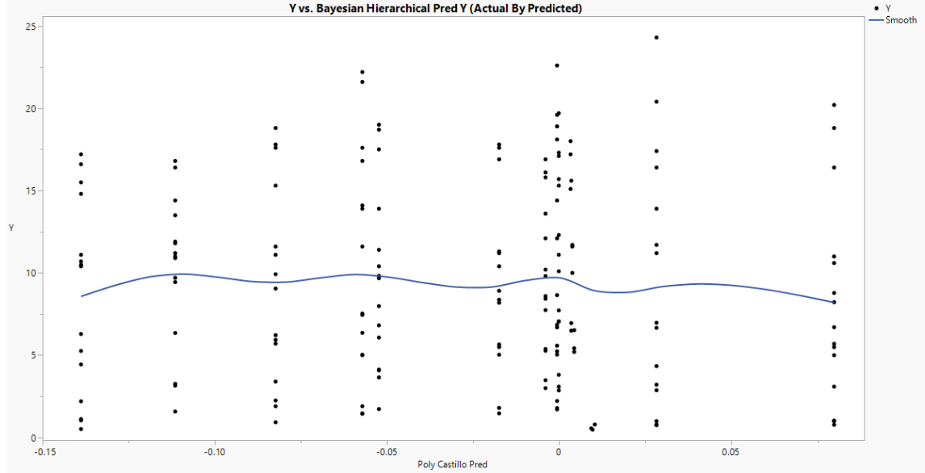
Example 3: DoE 10 Factor Data
Method: Bayesian Hierarchical Two-Stage Mixed-Effects
A horizontal trend is observed.
Variation is large throughout the whole plot.
Overall Bayes Method seems to be predicting Y values inaccurately.
Actual by Predicted plot for our Bayesian Hierarchical Two-Stage Mixed-Effects Method

Slide 42
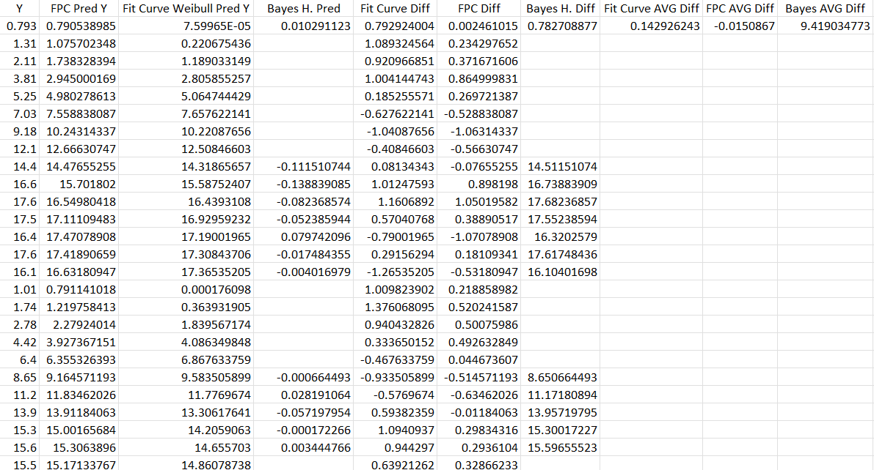
Example 3: DoE 10 Factor Data
Predicted Values against our Actual Y values for our DoE 10 Factor Data. We also compute the average difference between actual and predicted values for each method for comparison.

Slide 43
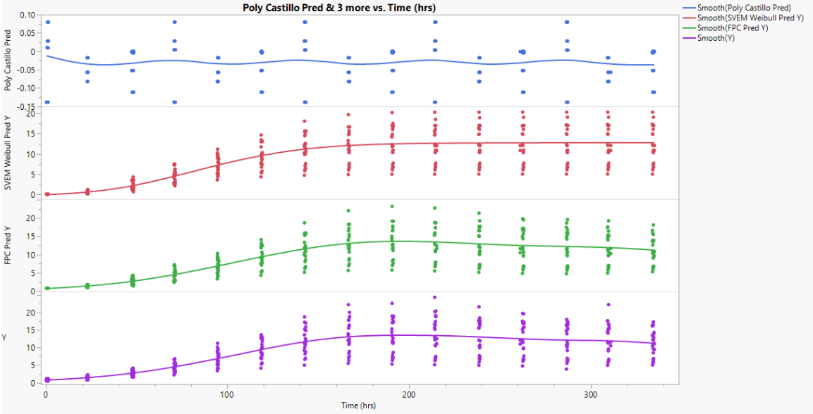
Example 3: DoE 10 Factor Data
Both Fit Curve and FPC predictions have very similar trend and shape to the actual Y values vs. Time.
FPC does account for the decrease in Y value as time increases over 300, Fit Curve does not account for it.
Overall Plot Comparison of our Predicted and actual Y values vs. Time for the DoE 10 Factor Data

Slide 44
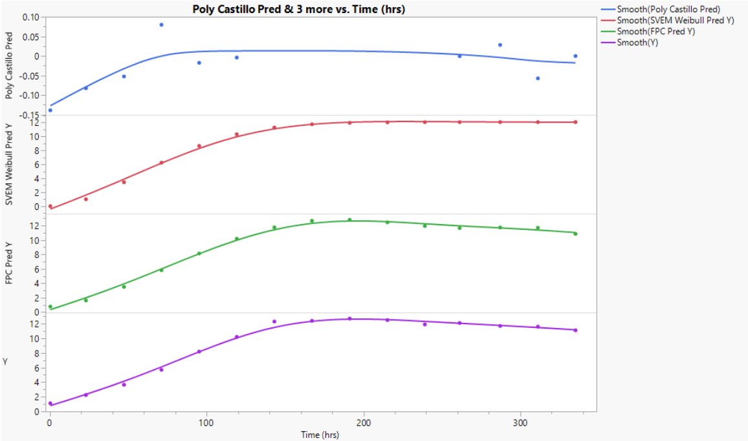
Example 3: DoE 10 Factor Data
Run 10 shows a clearer view of the drop in Y value as Time increases over 300 hours.
This decrease occurring in our FPC and not in our Fit Curve Method indicates that our FPC method performs the best in our DoE 10 Factor data example.
Predicted & Actual Y vs. Time Plot Comparison of Run 10 of our DoE 10 Factor Data

Slide 45
Conclusions
JMP's Fit Curve Method and Functional Principal Components (FPC) were found to be effective in modeling functional data responses as curves based on experimental factors.
Across all three datasets, the Bayesian Hierarchical Two-Stage Mixed-Effects method showed poor prediction accuracy.
Initial findings suggest FPC might be slightly more accurate than the Fit Curve method, but more research is needed to confirm this.
Future investigation of implementing the Bayesian Hierarchical Two-Stage Mixed-Effects method for prediction should proceed with caution due to its demonstrated inaccuracy.

Slide 46
Future Research
There are two primary avenues for further research in this field:
Simulation
Response Surface Modeling

Slide 47
Work Citied:
[1] Del Castillo, E., Colosimo, B. M., Alshraideh, H., Bayesian Modeling and Robust Optimization of Functional Responses affected by Noise Factors, JQT, 44(2), 2012.
[2] Ullah, Shoriat, Seo, K., Prediction of Lithium-Ion Battery Capacity by Functional Principal Component Analysis of Monitoring Data, Appl. Sci., 12, 4296, 2022. https://doi.org/10.3390/ app12094296
[3] Lemkus, Trent, Gotwalt, Christopher, Ramsey, Philip, Weese, Maria L., Self-validated ensemble models for design of experiments, Chemometrics and Intelligent Laboratory Systems, 219, 104439, 2021. https://doi.org/10.1016/j.chemolab.2021.104439
[4] Peterson, J. J., A Posterior Predictive Approach to Multiple Response Surface Optimization, Journal of Quality Technology, 36(2), 139–153, 2004.40
[5] Miro, G., Del Castillo, E., Peterson, J. J., A Bayesian Approach for Multiple Response Surface Optimization in the Presence of Noise Variables, Journal of Applied Statistics, 31(3), pp. 251–270, 2004.
[6] Govaerts, B., Noel, J., Analyzing the Results of a Designed Experiment when the Response Is a Curve: Methodology and Application in Metal Injection Moulding, Quality and Reliability Engineering International, 21, pp. 509–520, 2005.

